Slide 1
Scheduler Activations: Effective Kernel Support for the User-Level Management of Parallelism
Yen-Hsing Li

Slide 2
Problems
Threads can be supported either at user level or in the kernel. Neither approach has been fully satisfactory.
User level threads:
++ good performance, flexible.
-- blocking all threads in a process if block system call occurs.
Kernel level threads:
--worse performance
++only block a thread in a process if block system call occurs.

Slide 3
Goals and Approaches
Goal of this work:
Design a kernel interface and a user-level thread package.
Combine the functionality of kernel threads with performance and flexibility of user-level threads.
Approaches:
provide each application with a virtual multiprocessor.
Allow coordination between user and kernel schedulers

Slide 4
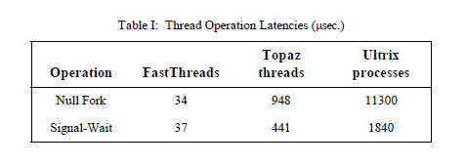
Performance Comparison
User-level
Threads
Kernel
Threads

Slide 5
Virtual Processor Design
kernel controls the allocation of processors to each address space.
user-level thread system controls which threads to run on its allocated processors.
The kernel notifies the user-level thread system whenever the kernel changes the number of processors assigned to it.
The user-level thread system notifies the kernel when the application needs more or fewer processors.

Slide 6
Scheduler Activations
Role
Running user-level threads, in exactly the same way that a kernel thread does.
It notifies the user-level thread system of a kernel event. -> Upcalls
Provide space in kernel to save context of user thread when kernel stops it.

Slide 7
Kernel Upcall Points
After kernel creates a scheduler activation, kernel upcalls into the application address space at a fixed entry point.
New processor available -> Run time picks user thread to use it
Activation blocked ->Runtime runs a different thread on the activation
Activation unblocked
Activation lost processor ->Context remapped to another activation

Slide 8
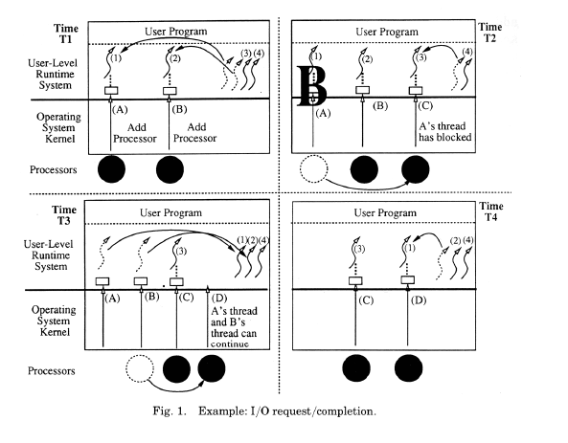
Scheduler Activation example

Slide 9
Critical Sections
User-level thread could be executing in a critical section at the instant when it is blocked or preempted. This may lead to:
Poor performance
Deadlock
Continues the user thread using a user level context switch until the lock is released.

